Slide 1

Human Error
All Types of Slips in our Everyday Actions
Oindrila Chowdhury
Supervisor: Dr. Tabin Hasan

Slide 2
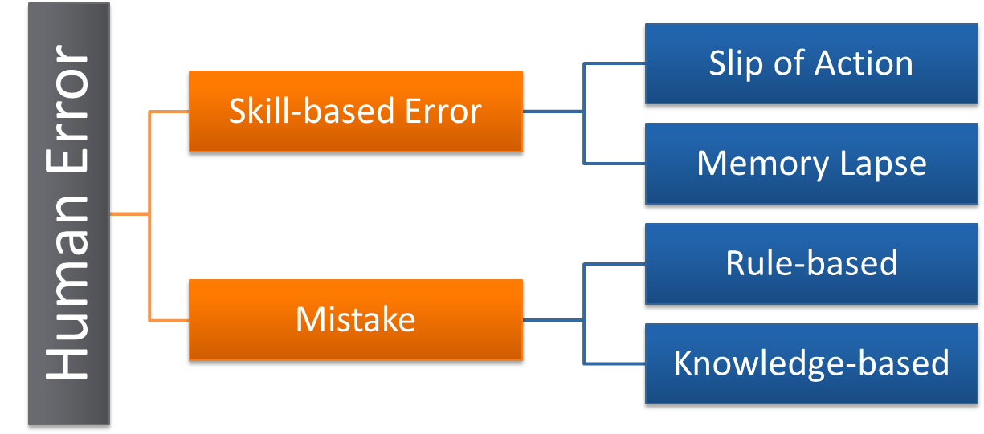
Human Error
Human Error is commonly defined as a failure of a planned action to achieve a desired outcome.
Errors can occur in both the planning and execution stages of a task. Plans can be adequate or inadequate, and actions (behaviour) can be intentional or unintentional.

Slide 3
Slip
Slips result from automatic behavior, when subconscious actions that are intended to satisfy our goals get waylaid in route. Slips are almost always small things: a misplaced action, the wrong thing moved, a desired action undone. Moreover, they are relatively easy to discover by simple observation and monitoring.
There are several classifications of human slips. I’ll discuss about all types of slips in everyday life on upcoming slides.
Short Term Memory
Long Term Memory
S T M
L T M
Behaviour of Brain
Visible

Slide 4
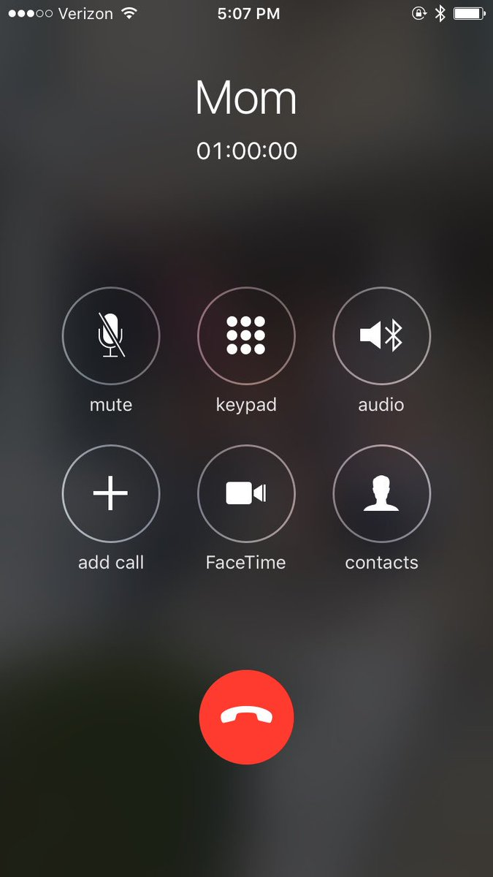
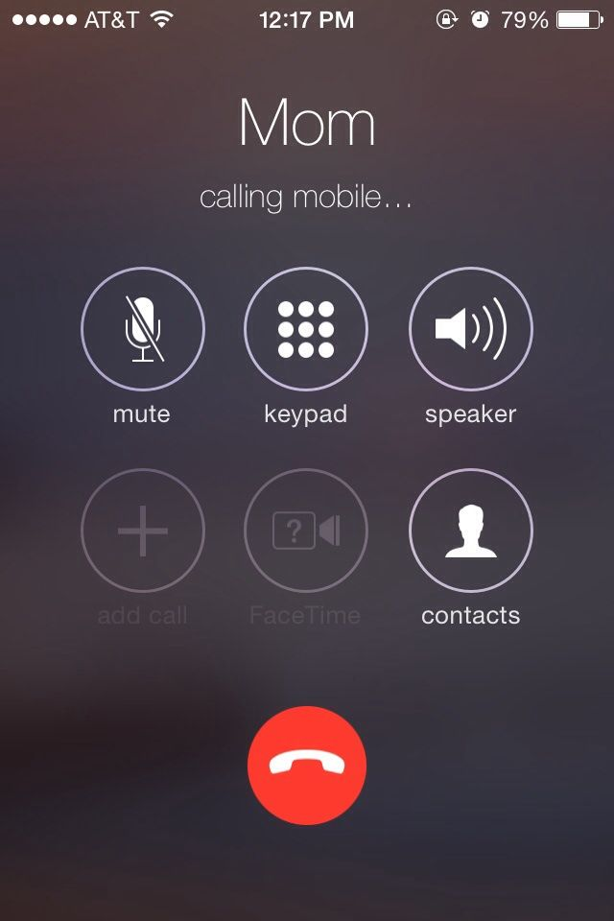
Capture Error
A capture error occurs when a more common and practiced event is performed when a similar but less familiar activity was expected. In short time memory when any information becomes static that is the Capture Error.
I used to talk to my mother 6-7 times a day when I was in hostel in Dhaka. And we talk for at least 5-10 minutes in each call. One day, my mother called me and told me to call my father. Instead of typing my father's contact number, I typed my mother's contact number and called her. But I was going to call my father instead of my mother. This is a capture error as my mother's number becomes static in my brain for a short time.

Slide 5
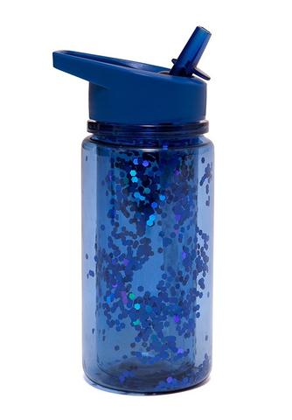

Description Error
A Description Error, or more simply a human error, happens when a person performs the correct action on the incorrect object as a result of inadequate definition of an action that would have resulted in the intended result. When identical acts yield different outcomes, this is a common occurrence.
I regularly wake up and drink a glass of water from the colourful jar in my dinning table. Today I woke up and when I went to drink water, I poured some mango juice from the jar. yesterday I blended some mangoes, made some mango juice and put them on the jar from where I get my water. As I regularly take my drinking water from the colourful jar, the repetition of the activity made me to pour water from the jar even though I have put the mango juice on that same jar.

Slide 6
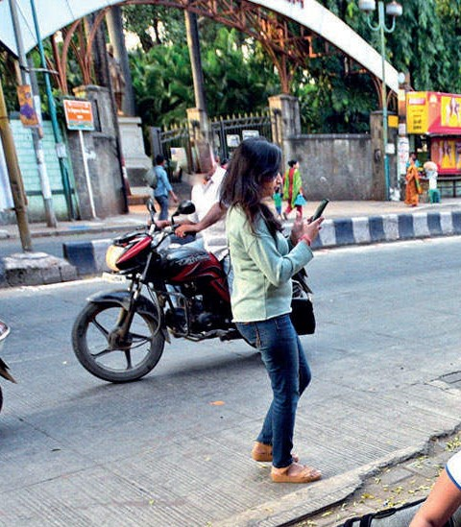
Data Driven Errors
Data Driven Error is when an automatic routine applies the wrong information because the wrong information was immediately available to perception.
Every week, from Sunday to Thursday at 10 AM, I used to go to university from my hostel at [Bashundhara Block B] to attend my classes. But one day at Friday, I decided to visit my friend who lives in block C at road no.3. I left my house at 10 AM to visit my friend but instead of taking the route of her home, I started to walk in road no 5,block C & took the way to my university but I didn't notice. After reaching my university unintentionally, I discovered that, because of everyday I move to university at 10 AM, instead of taking the path to my friend's house, I took the path of my university.

Slide 7
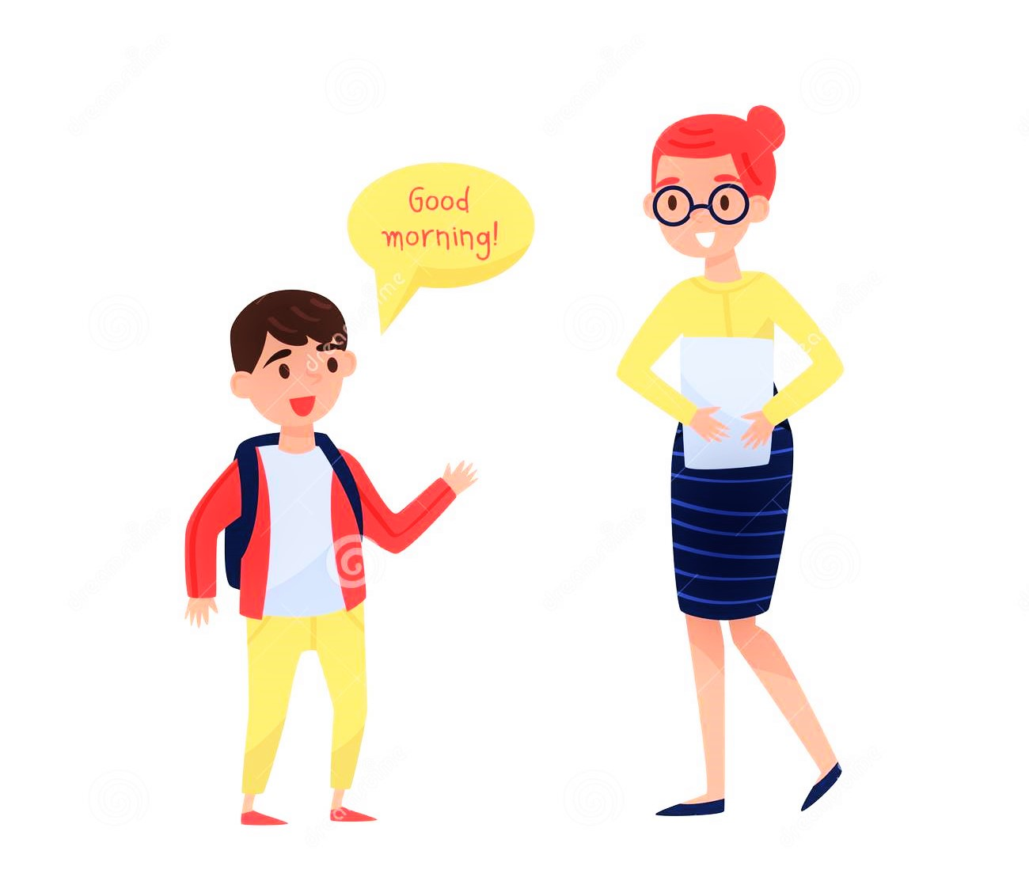
Associative Activation Errors
Associative Activation Errors is a type of slip identified by Norman that is caused by an internal association of two activities.
When I was in school, I used to greet my teacher saying "Good morning, ma'am" when she entered the class in school in the morning. One day, in the evening, I saw her crossing my house and I told her "Good morning. ma'am" instead of saying "Good evening' ma'am". After realising my fault, I felt embarrassed as everybody around me was looking at me for saying "Good morning, ma'am" in the evening.

Slide 8

Loss of Activation Error
Loss of Activation Errors is a type of slip identified by Norman where one action is executed but the goal of the action or a subsequent action is forgotten.
One day, I along with my mother was cooking in the kitchen. Suddenly my mother asked me to bring the scissor from my study table in my room. As I was already busy in cleaning the dishes. After completing my work, I went out to bring the scissor from my study table, but suddenly I missed out what I was supposed to bring from my room. I stood there for a while and but couldn't remember anything. Then I again asked my mother what I was supposed to bring from my study table and she again reminded me to bring the scissor from my study table so that she can cut the packet of flour.

Slide 9
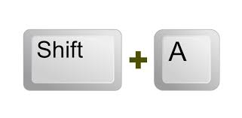
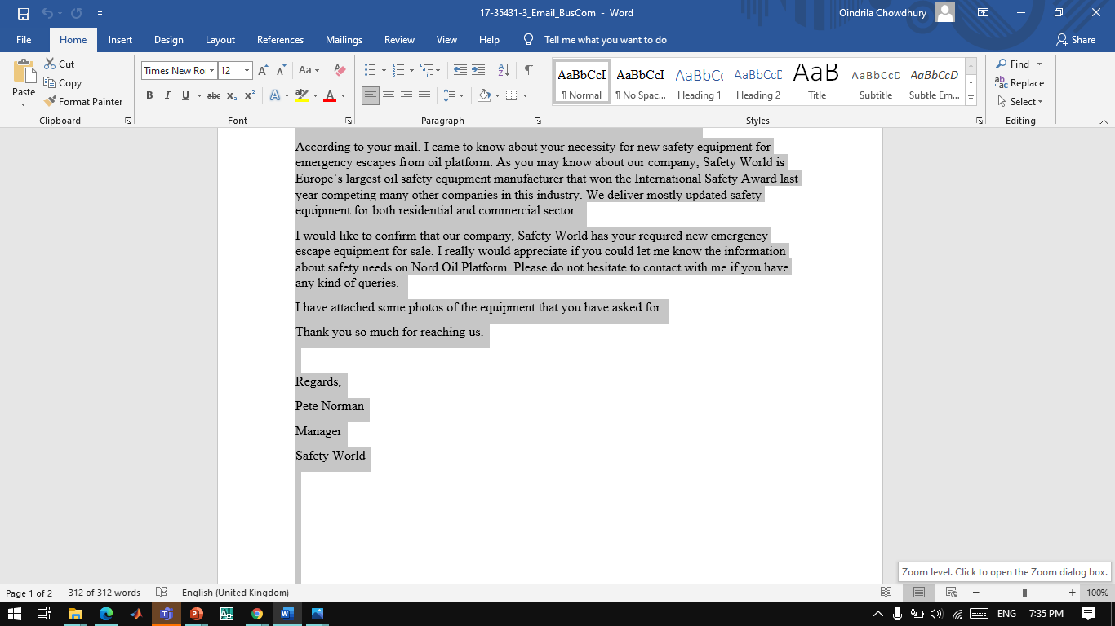
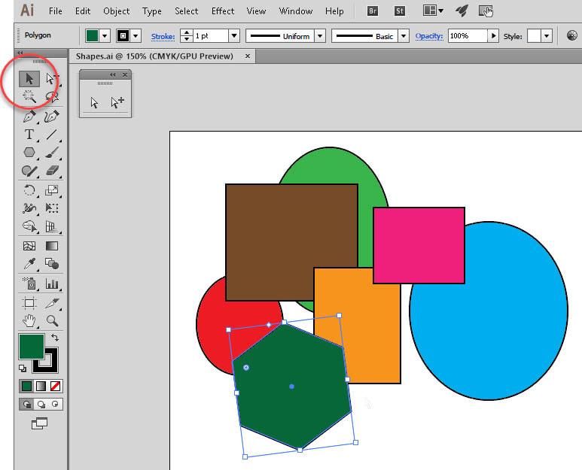
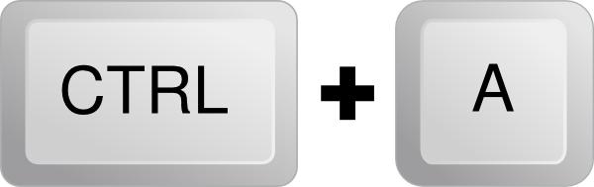
Mode Errors
Mode Errors occur when the user tries to invoke an action that doesn't have the desired effect in the current mode.
In MS Word, I was used to select all data / information by pressing "Ctrl + A". But after using MS Word for a while, I remembered I need to work for a visual in Adobe Illustrator. So, I entered into Adobe Illustrator and made some visuals. But when I needed to select all the visuals at a times, I pressed "Ctrl + A" as like as I did in the MS Word. But instead of selecting all visuals, Adobe Illustrator zoomed into my visuals. So, I searched for "How to select all visuals in Adobe Illustrator?" and I found out in Adobe Illustrator, the user need to press "Shift + A" to select all his visuals. And the "Ctrl" button works for zooming into the visuals instead of selecting the visuals in Adobe Illustrator unlike MS Word.

Slide 10


